Slide 1
Combinatorial System in Monkey “Language”
Shigeru Miyagawa
MIT/UTokyo
Creteling
July 2018

Slide 2
Combinatorial system in human language
Merge (Chomsky 1995, 2013, etc.)
Merge applies to two objects α and β, and forms a new object
γ = {α, β}.
Recursion lies in its ability to describe an infinity of (input, output) pairs by a finitely definable set of operations in an effectively computable manner… (Luuk and Luuk 2011).

Slide 3
α β

Slide 4
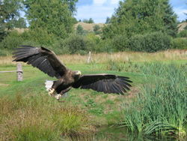
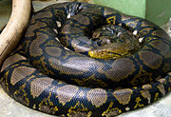
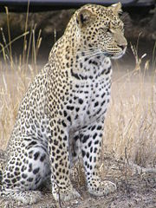
Do non-human animals have a combinatorial system?
Vervet monkeys of Kenya
(Seyfarth, Cheney, Marler 1980 Science)
eagle 鷲 snake へび leopard レパード
bees

Slide 5
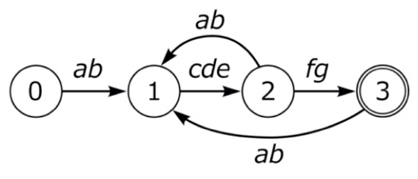
Combinations that generate new meanings
α_{M1 +} β_{M2} => γ_{M3}
Bengalese Finch
No new meaning
No structural hierarchy

Slide 6
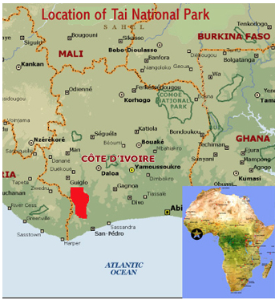
Campbell’s Monkeys
“Campbell’s Monkeys Use Affixation to Alter Call Meaning”
Karim Ouattara, Alban Lemasson, Klaus Zuberbühler, PLoS ONE 2009
The adult males of six wild Campbell’s
monkey groups in the Tai Forest

Slide 7
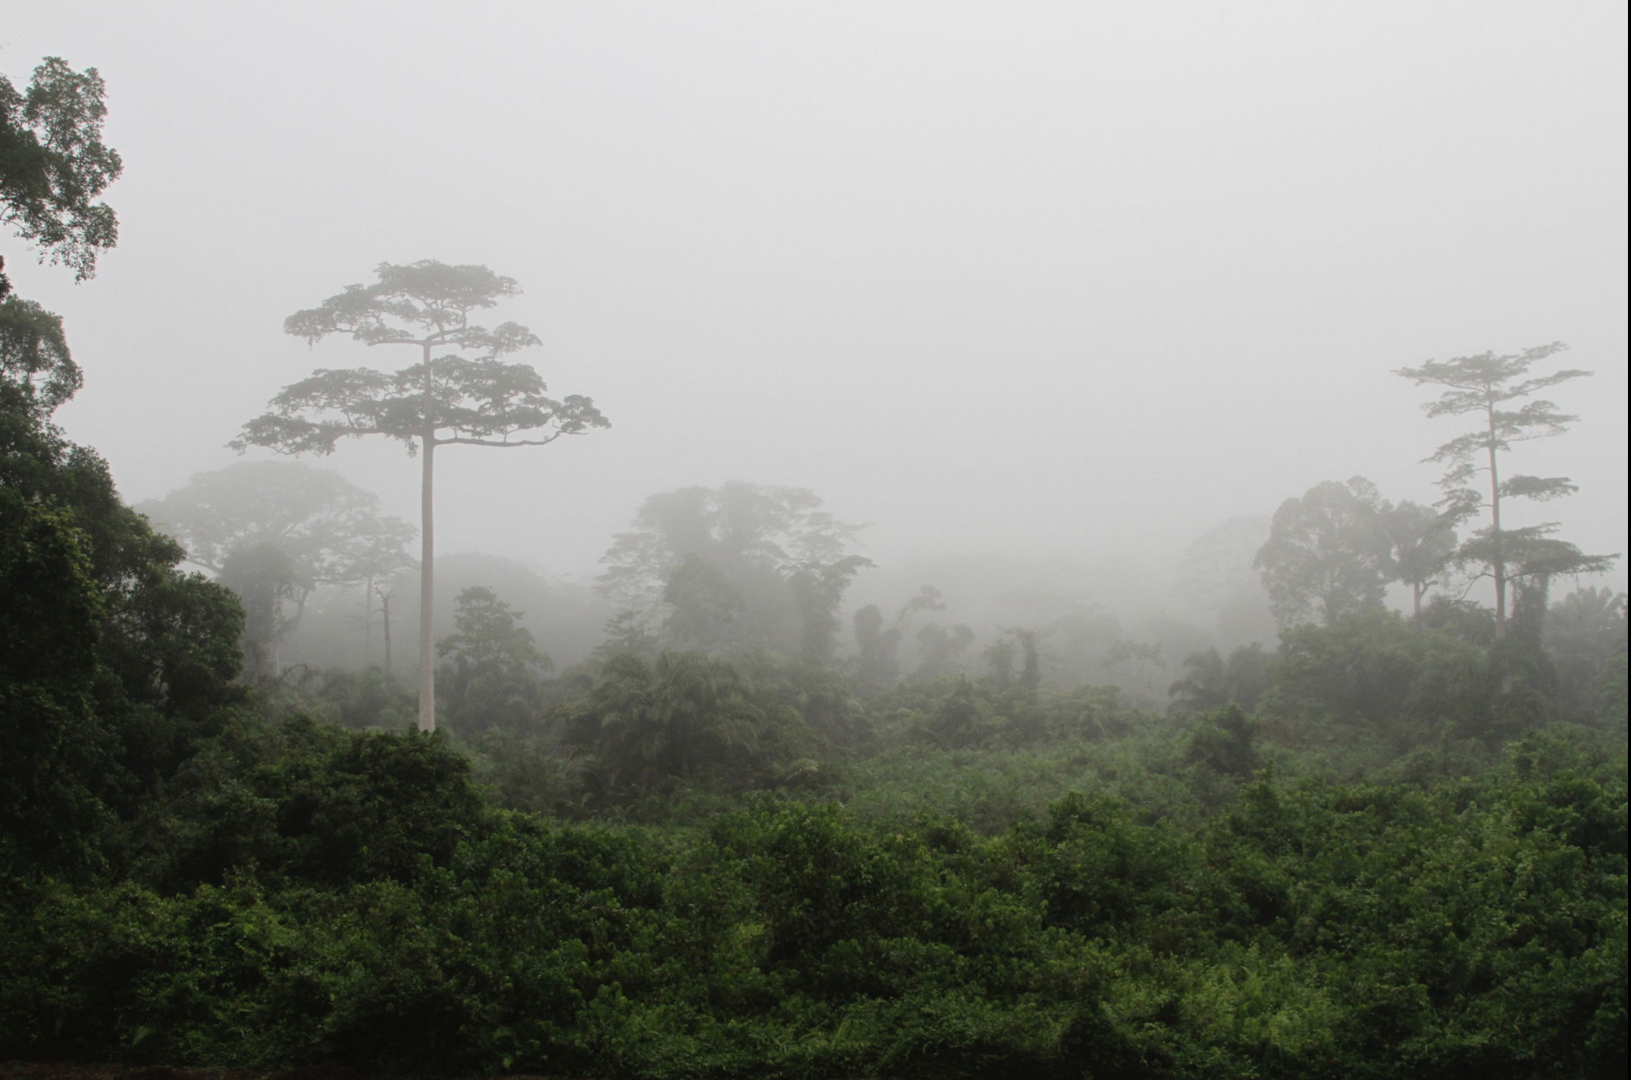

Slide 8
Affixation in the alarm calls of free-ranging adult Campbell’s monkeys (Cercopithecus campbelli campbelli)
Male alarm calls are composed of an acoustically variable stem, which can be followed by an acoustically invariable suffix.
Suffixation functions to broaden the calls’ meaning by:
(i) transforming a highly specific eagle alarm to a general arboreal disturbance call;
or
(ii) by transforming a highly specific leopard alarm call to a general alert call.

Slide 9
Limited to pairs, or “flat” sequences
Campbell’s monkey
R + oo
Never: [R + oo] + [R/oo/R-oo]
Putty-nosed monkeys (Arnold and Zuberbühler 2012)
pyow (=P) and hack=(H);
Pyows function as general alert calls, whereas hacks are usually related to aerial predators.
PPPHHH (can only be used for non-risk-related situations)
*PHPHPHPH (cf: *[[[[PH]PH]PH]PH])

Slide 10
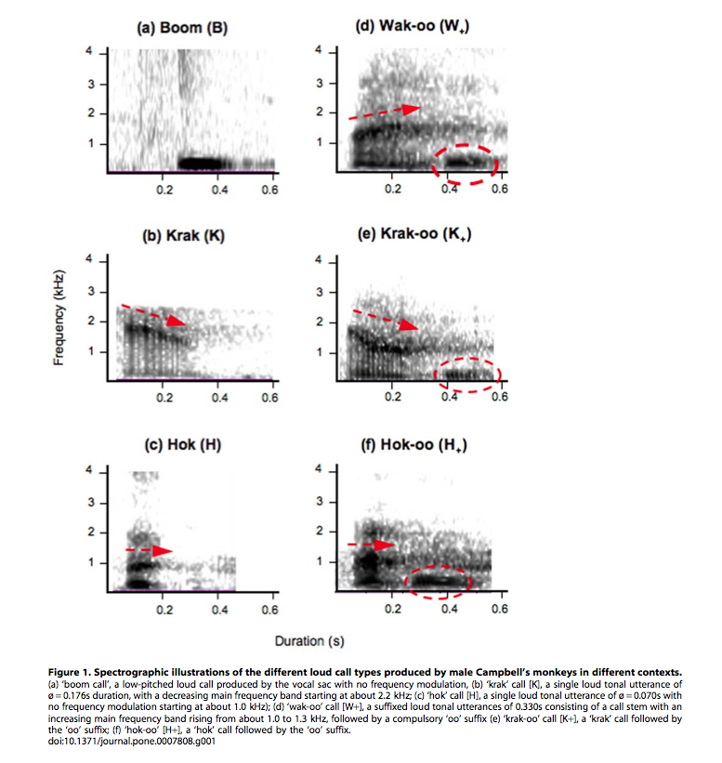
Stems and an affix
The adult males consistently produced six different loud alarm call types:
boom
krak
hok
wak-oo
krak-oo
hok-oo
All were perceptually
distinct to a human
observer.

Slide 11
“Meaning” of Campbell alarm calls
The three habituated males, who were tolerant to direct observations, produced their loud calls to a variety of disturbances, including both predatory and non-predatory events.
krak : exclusively given after detecting a leopard, suggesting that it functioned as a leopard alarm call
krak-oo : given to almost any disturbance, suggesting it functioned as a general alert call.
hok : almost exclusively associated with the presence of a crowned eagle (either a real eagle attack or in response to another monkey’s eagle alarm calls)
hok-oo : given to a range of disturbances within the canopy, including the presence of an eagle or a neighbouring group (whose presence could sometimes be inferred by the vocal behaviour of the females)

Slide 12
On hok and hok-oo
On a few occasions, hok and hok-oo calls were produced in response to a flying squirrel, whose silhouette somewhat resembles a flying eagle, but never to any other large bird.
While producing hok-oo calls, males adopted a threat posture, combined with flashing their eyelids, and they sometimes conducted a short dash towards the disturbance.
Adding an oo unit to hok, thus, indicated that the male was aggressively motivated -- in response to a general disturbance within the canopy, e.g., a perched eagle or a conspecific opponent.

Slide 13
Wak-oo and boom
Wak-oo calls were given to the same events as hok-oo calls (eagles, other flying animals, Diana monkey eagle alarms), but for some reason never to neighbours.
Boom calls were only given to non- predatory contexts, such as a falling branch or tree, to initiate or halt group travel, during disputes with neighbours, and during any unusual vocal excitation within the group.

Slide 15
Field experiments
To investigate the predator warning function more directly, we performed a series of field experiments that simulated the presence of the different predators, using both visual and acoustic models.
Detecting a predator never triggered any boom calls.
In contrast, the general alert call krak-oo was given in all four conditions
krak calls were only produced in the presence of leopards.
wak-oo calls were given to eagles
hok and hok-oo calls were primarily given to visual eagle models

Slide 17
The key finding of this study was that males adhered to a simple affixation rule, which increased their small basic vocal repertoire. Krak and krak-oo as well as hok and hok-oo calls were composed of the same call stem elements, while the rapid addition of the oo affix generated a significant change in the semantic content in terms of the types of external events the calls referred to.

Slide 18
Displacement
“Campbell’s monkeys concatenate vocalizations into context-specific call sequences” Karim Ouattara, Alban Lemassona, and Klaus Zuberbühlerd, PNAS 2009
There was a significant difference in the proportion of H and H+ calls if the caller spotted a real eagle or encountered the eagle model compared to when he only heard eagle vocalizations or Diana monkey eagle alarm calls.
Human language is symbolic in the sense that signalers can inform listeners about referents that are not physically present. In Campbell’s monkeys, we only observed calling in response to real life experiences, and some observations suggested that callers did not attempt to inform others. DISPLACEMENT

Slide 19
Schlenker et al.
“Formal monkey linguistics”
Philippe Schlenker*, Emmanuel Chemla, Anne M. Schel, James Fuller, Jean-Pierre Gautier, Jeremy Kuhn, Dunja Veselinović, Kate Arnold, Cristiane Cäsar, Sumir Keenan, Alban Lemasson, Karim Ouattara, Robin Ryder and Klaus Zuberbühler
Theoretical Linguistics 2016
“Monkey semantics: two ‘dialects’ of Campbell’s monkey alarm calls”
Philippe Schlenker • Emmanuel Chemla • Kate Arnold • Alban Lemasson • Karim Ouattara • Sumir Keenan • Claudia Stephan • Robin Ryder • Klaus Zuberbühler
Linguistics and Philosophy (2014)

Slide 20
Dialectical variation
Schlenker et al. (2014) discussed comparative data (due to Arnold and Keenan) — apparent dialectal variation between the Tai forest(Côte d'Ivoire) and Tiwai island (is a wildlife sanctuary and tourist site in Sierra Leon): krak has a primarily leopard-related meaning in Tai (where leopards exist), the same call is used as a general alert call on Tiwai, where leopards have been absent for decades.
Schlenker et al. (2014) developed several possible analyses, one of which posited that:
krak was a general alert call on both sites
hok was related to non-terrestrial disturbances
boom involved non-predation situations
-oo had a (compositional) attenuative function.

Slide 21
“Lexical meanings” (Schlenker et a. 2014)
Informal description of the lexical meanings
a. boom boom: ‘this is not a situation of predation’
b. hok-oo: ‘there is an alert upwards’
c. hok: ‘there is an eagle’
d. krak-oo: ‘there is an alert’
e. krak: (i) ‘there is a leopard’ (Tai); (ii) ‘there is an alert’ (Tiwai)

Slide 22
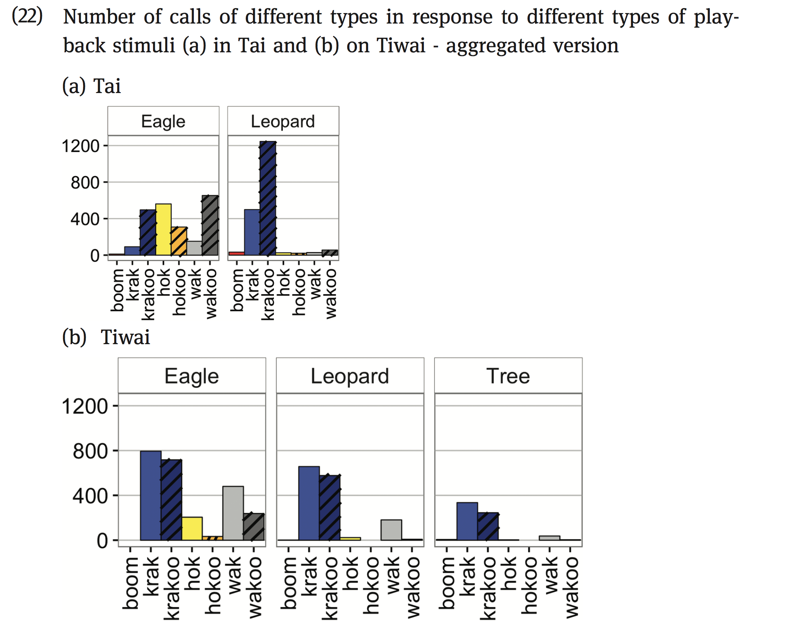

Slide 23
Problem with the analysis in Schlenker et al. 2014
Schlenker et al. 2016
First, on the assumption that the meaning of krak-oo is derived from the meanings of krak and -oo, it is unlikely that a leopard meaning for krak could yield a general meaning for krak-oo. If krak is applicable just in case there is a leopard in the relevant situation, we would expect krak-oo to be used when one should pay attention to a threat coming from the ground — Campbell’s monkeys are arboreal and leopards come from lower down (even when they climb).

