Slide 1
Cave art

Slide 2
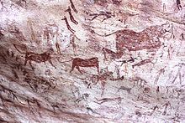
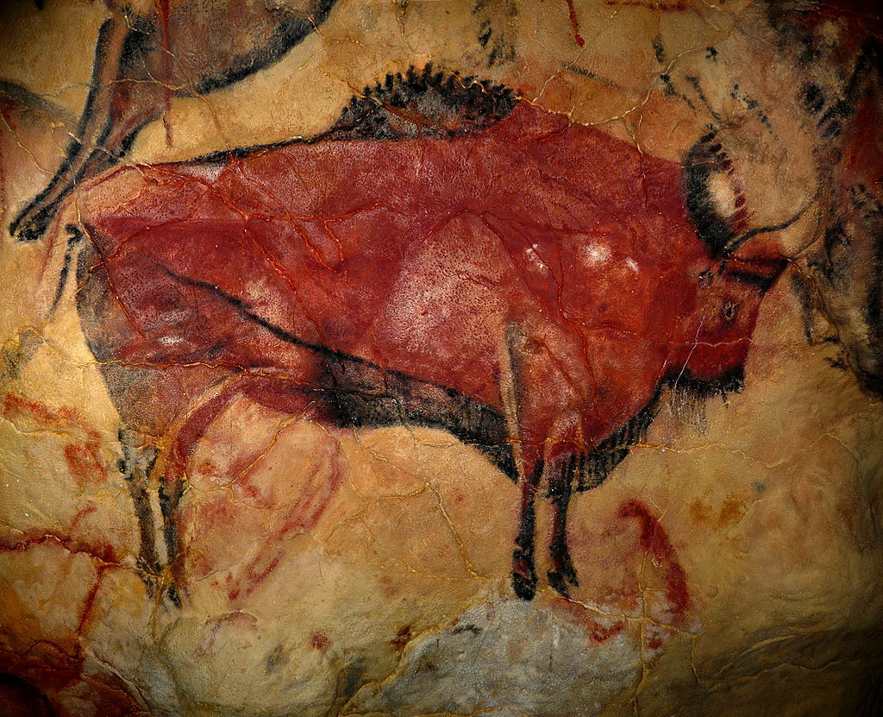
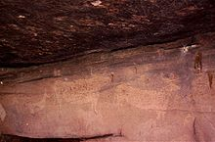
Cave art

Slide 3
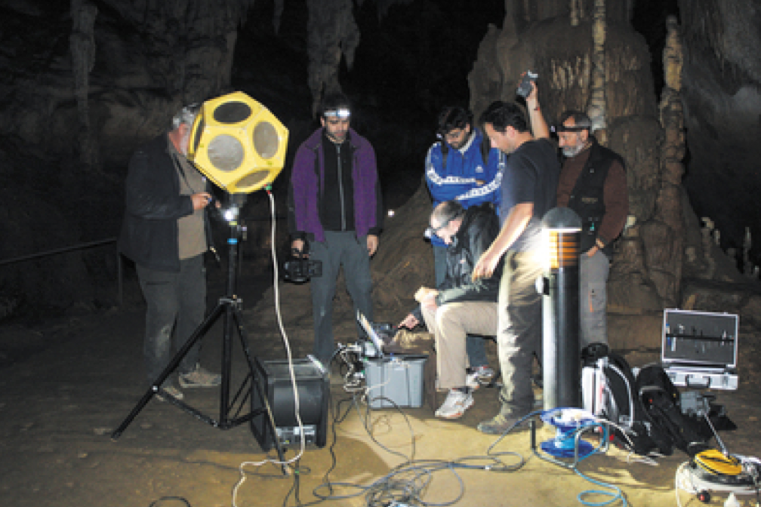
Deep in caves, difficult to access, dark
Concentrated in narrow areas
90% are of hoofed animals – horses, deer
Archeoacoustics (Robert Till, etc)
Cave entrance
Inside cave
Deep in cave

Slide 4
Rock Art Acoustics in the Past, Present and Future, Steven J. Waller 1999
The author has found that rock art often occurs at the exact location of the source of sound reflection and/or at a good spot in which to stand for hearing an echo come from elsewhere.
For example, echoes of percussion noises such as clapping can mimic the sound of hoof beats, and hoofed animals are a frequent rock art theme.
Voices appear to emanate from rock surfaces on which anthropomorphic beings are depicted. Thus the artists may have been attempting to depict the spirits who they felt inhabited the rocks and who were responsible for the sounds.
Digital measurements of sound reflection revealed that the decorated surfaces in Horseshoe Canyon correspond exactly to the regions of the canyon possessing the maximum echo intensities (R = .84; p < .0001).
Acoustic studies have substantiated the existence of sound reflection at virtually all of the rock art sites tested by the author to date in Europe, North America and Australia (Waller 1994a, 1997a, 1997b).

Slide 5
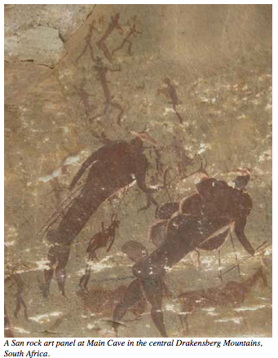
San rock art (70,000 years ago)

Slide 6
In southern Africa alone, there are perhaps over a million cave art images (Coulson and Cambell 2001)

Slide 7
Predominance of animals in cave art
Chauvet cave
Human brain is finely tuned to detect
animals (Hodgson 2013, etc.)

Slide 8
Handmarks
El Castillo

Slide 9
Development of art
Decoration of the body (pigments, ochre; e.g., Hoffman 2018, Pettitt 2011)
Handmark, a direct extension of the body (H. sapiens, but possibly also Neanderthals)
Portral of animals, triggered by brain attuned to detect them, and resonant environments such as caves
Hodgson and Pettitt (2017)

Slide 10
Back to Neanderthal cave art
… cave art was being created in all three sites at least 20,000 years prior to the arrival of Homo sapiens in western Europe.
We don’t know the exact meaning of the paintings…Some of them were painted in pitch black areas deep in the caves…The locations appear deliberately selected, the ceilings of low overhangs or impressive stalagmite formations. These must have been meaningful symbols in meaningful places.
Standish and Pike, May 22, 2018

Slide 11
WHEN DID LANGUAGE BEGIN?

Slide 12
A large recent genomic study among Khoe and San groups of Africa reveals that these groups are descendants of the earliest diversification event in human evolutionary history.

Slide 13
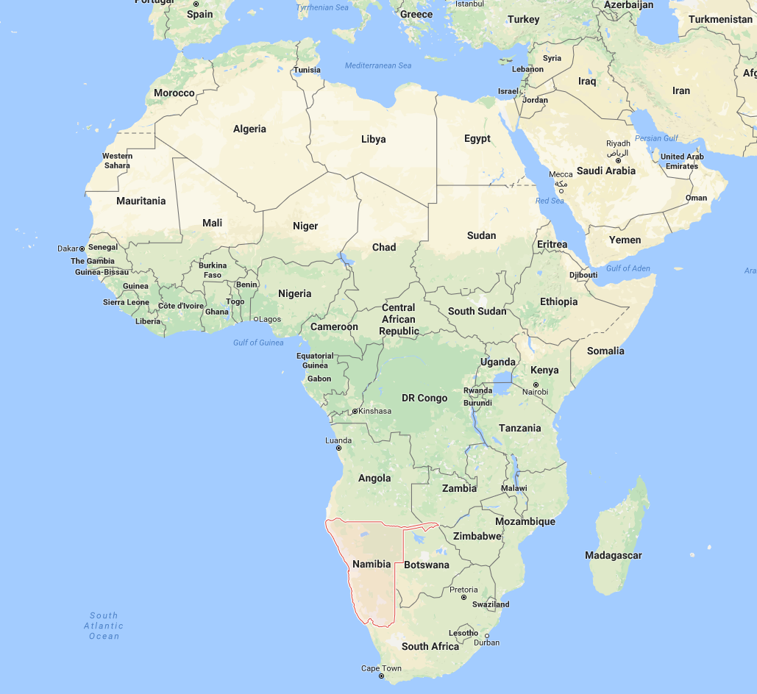
Khoisan tribespeople are genetically distinct not only from Europeans and Asians, but also from all other Africans. Nature Communication 2014
Khoisan population are unique
in having clicks.

Slide 14
KHOISAN SPLIT, 122KYA
BLOMBOS CAVE OCRE, 100KYA
RAPD INNOVATION IN TOOL TECHNOLOGY, ~100KYA

Slide 15
WHERE DID LANGUAGE COME FROM?

Slide 16
Birdsong is the “nearest analogy to language”
Darwin (1871)

Slide 17
Birds and Humans (Pfenning et al. 2014)

Slide 18
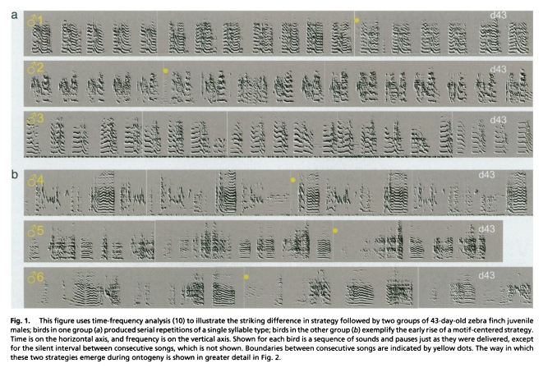
Two styles of learning: serial and motif
Liu, Gardner, Nottebohm 2004
Liu, Wan-chu, Timothy Gardner, Fernando Nottebohm. 2005. Juvenile zebra finches can use multiple strategies to learn the same song. PNAS vol. 101, no. 52, 18177-18182.

Slide 19
Two styles of learning for humans
Analytic
Gestalt
O’Grady 2005
dancing

Slide 20
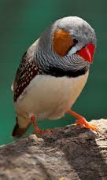
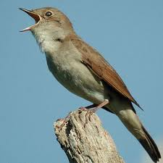
Variety
Songs might consist of fixed sequences with only sporadic variation (e.g. zebra finches)
Others show more variable sequences (e.g. nightingales, starlings, or Bengalese finches ); for example, a song of a nightingale is built out of a fixed
4- second note sequence. An individual
nightingale has 100– 200 song types
Berwick et al 2011

Slide 21
Bengalese finch

Slide 22
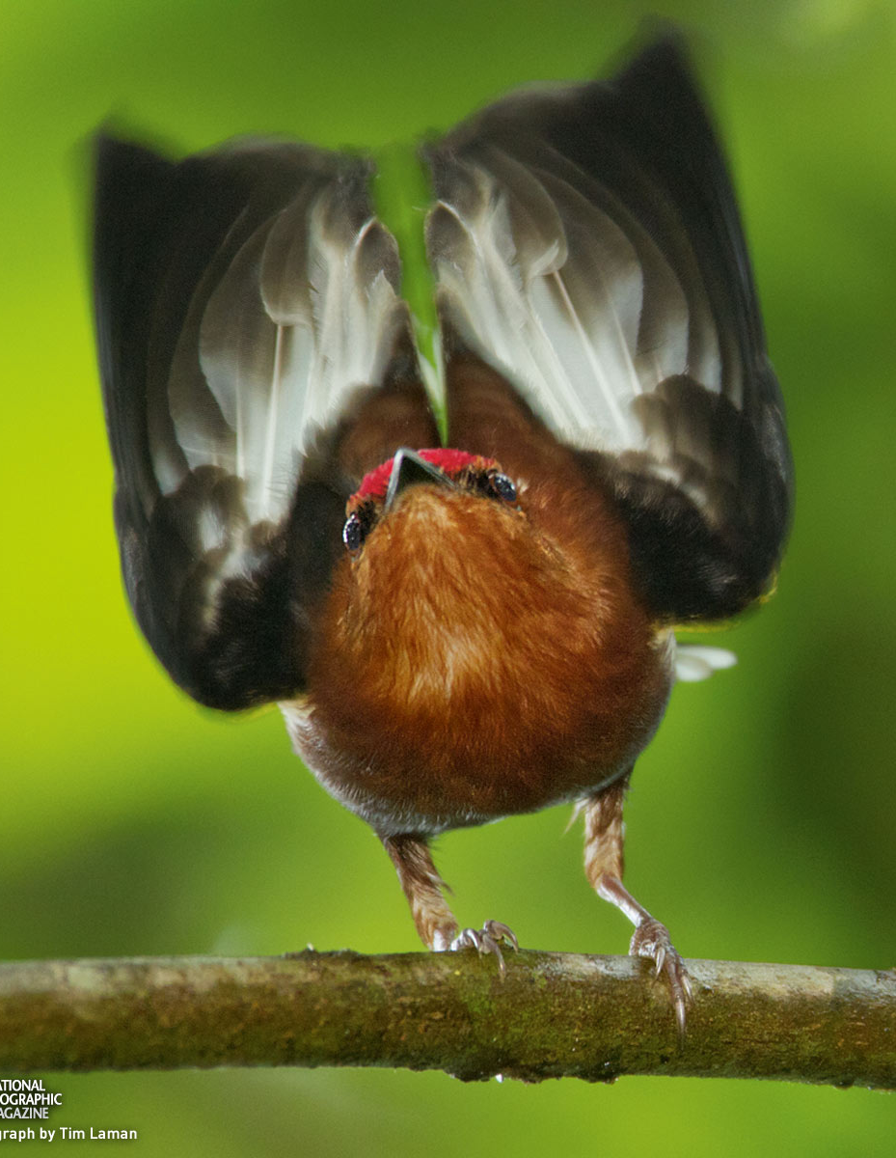
Creating Sound: Club-winged Manakin
cloud forest of Ecuador and SW Columbia
males flick wings back and knocks them together
vibrates to produce high pitched buzzing sound (1498 Hz)
high speed video shows wings knock together 107 times/second (107 Hz)
107 x 14 = 1498
http://ngm.nationalgeographic.com/2012/05/manakins/img/01-club-winged-manakin-makes-music_1600.jpg (Tim Laman)
Bostwick et al (2010) Proc. Roy. Soc. B277, 835-841 Fig. 1.]

Slide 23
PROBLEM: BIRDSONG DOESN’T
HAVE ANY WORDS

Slide 24
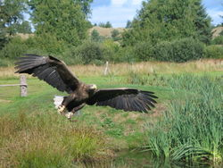
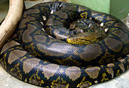
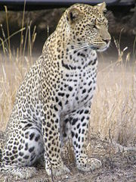
Conveying meaning in the animal world
Vervet monkeys of Kenya
(Seyfarth, Cheney, Marler 1980 Science)
eagle 鷲 snake へび leopard レパード
bees

